Slide 1
How JS works behind the scene

Slide 2
Theory is important
This is essential to make yourself a better programmer!
When you know these things you can always find better solutions
When something goes wrong with the code, you will know what is it
Learning is continuous process, so don’t stop here

Slide 3
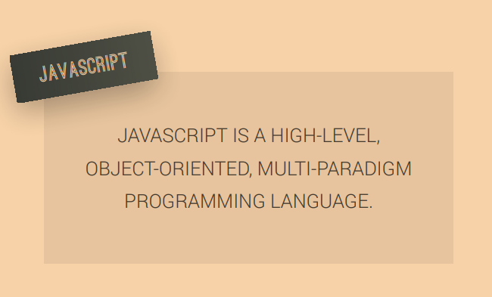
Let’s start with simple definition

Slide 4

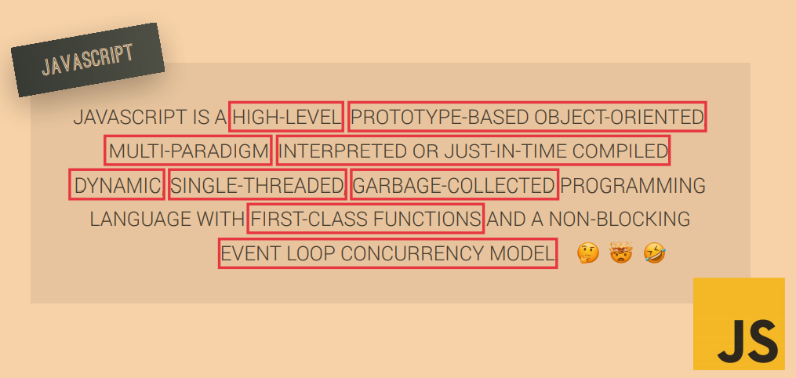
An then come to blow-minding definition

Slide 5
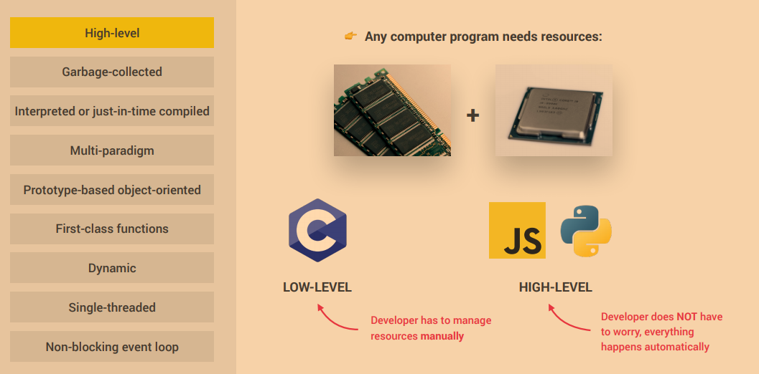
Definition in smaller pieces –part 1

Slide 6
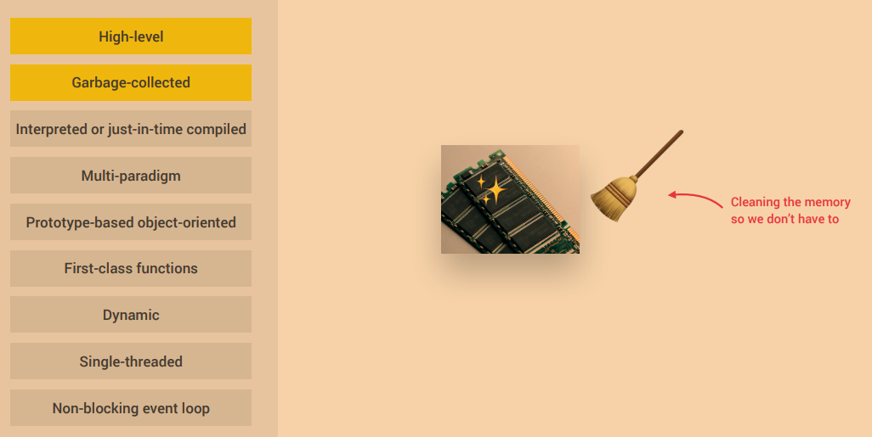
Definition in smaller pieces –part 2

Slide 7
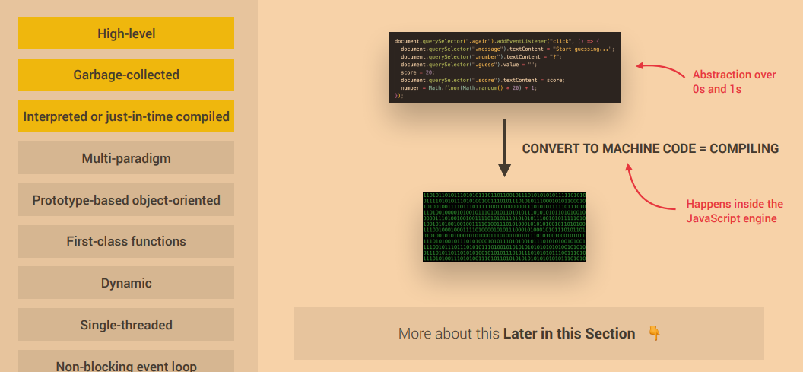
Definition in smaller pieces –part 3

Slide 8
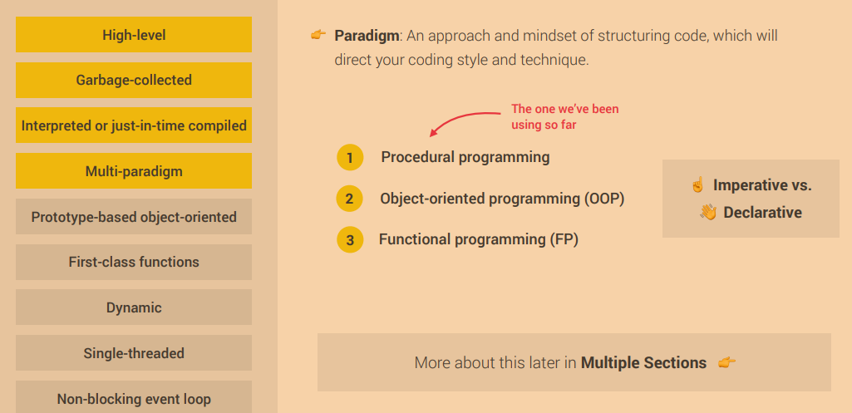
Definition in smaller pieces –part 4

Slide 9
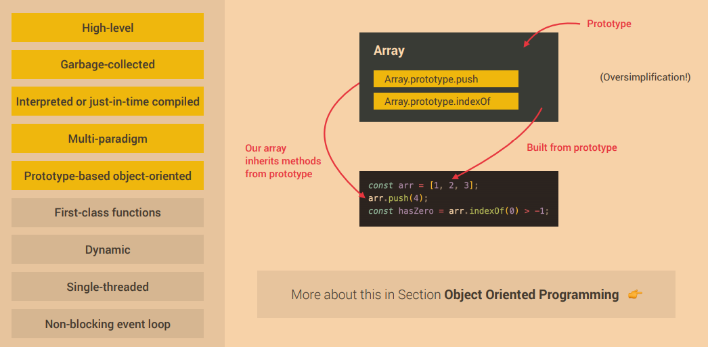
Definition in smaller pieces –part 5

Slide 10
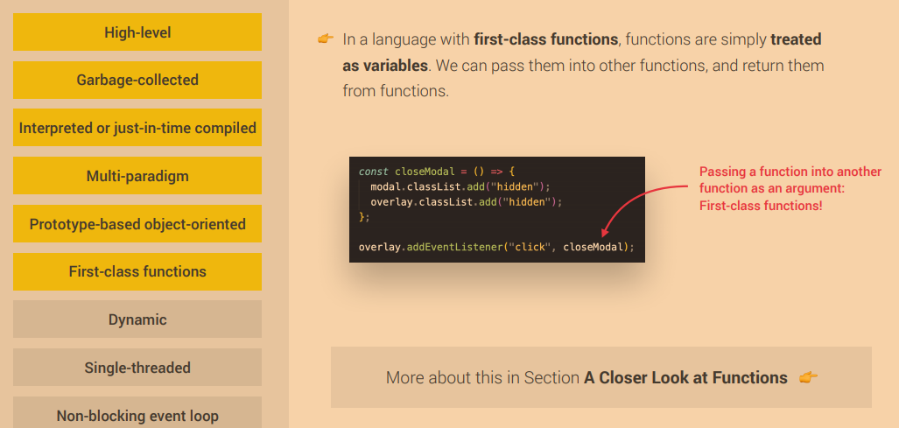
Definition in smaller pieces –part 6

Slide 11
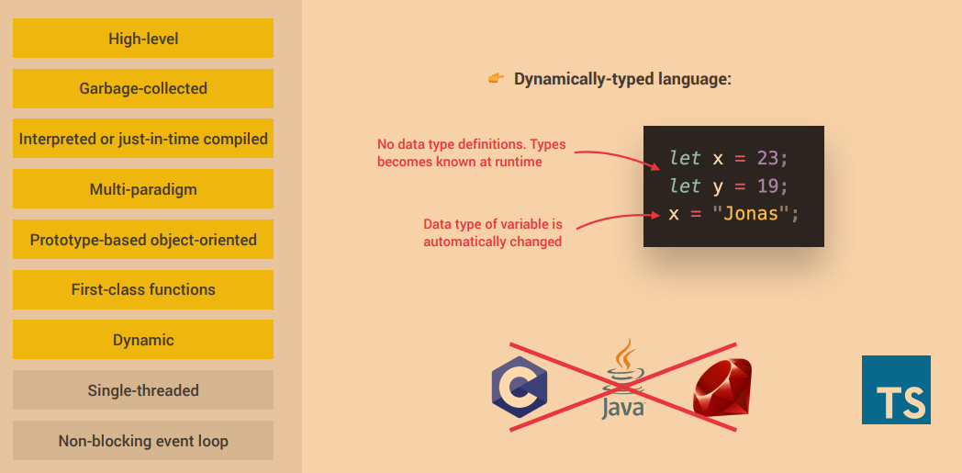
Definition in smaller pieces –part 7

Slide 12
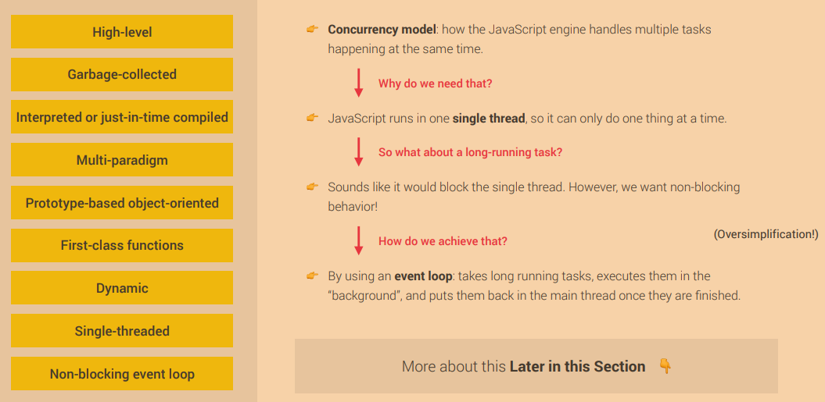
Definition in smaller pieces –part 8

Slide 13
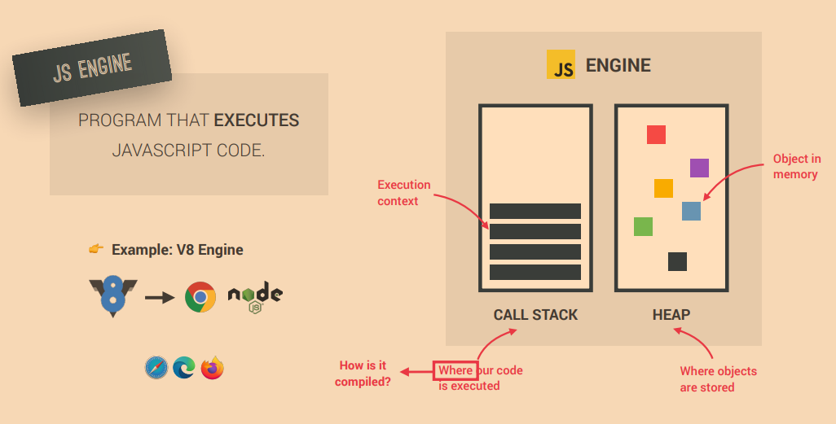
What is a javascript engine

Slide 14
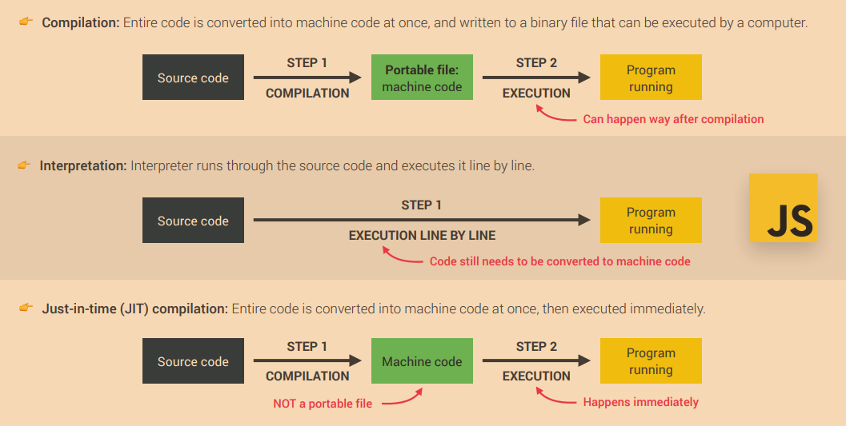
Compilation vs Interpretation

Slide 15
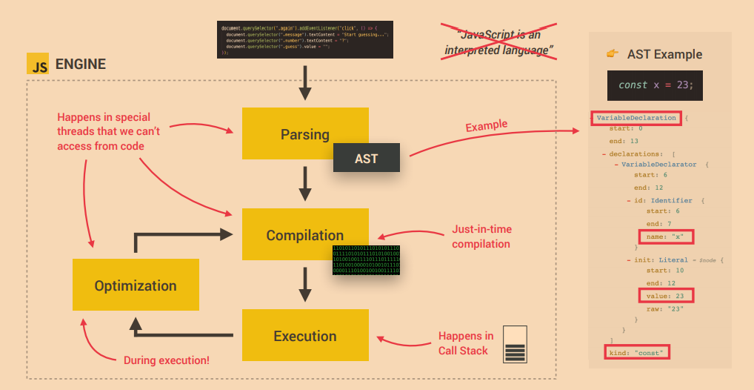
Just in time compilation

Slide 16
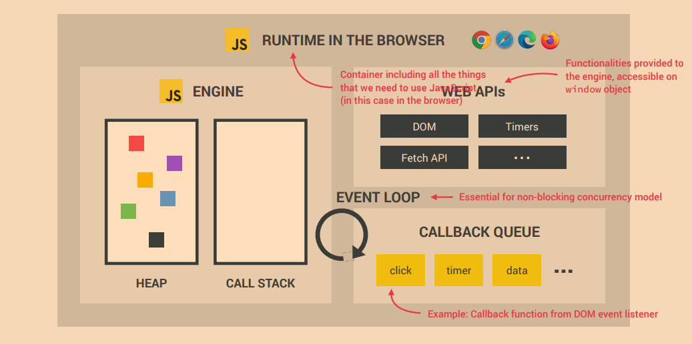
Runtime in browser

Slide 17
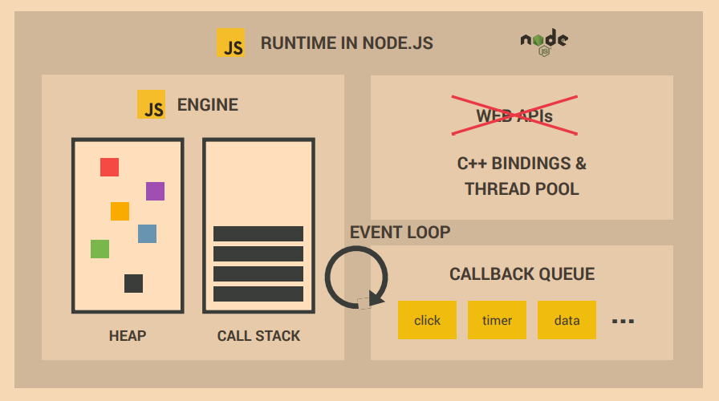
Javascript Runtime

Slide 18
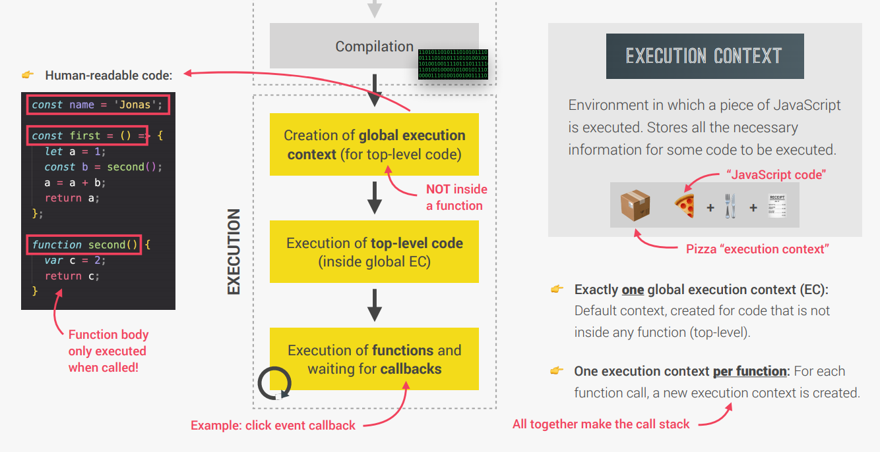
Execution Context

Slide 19
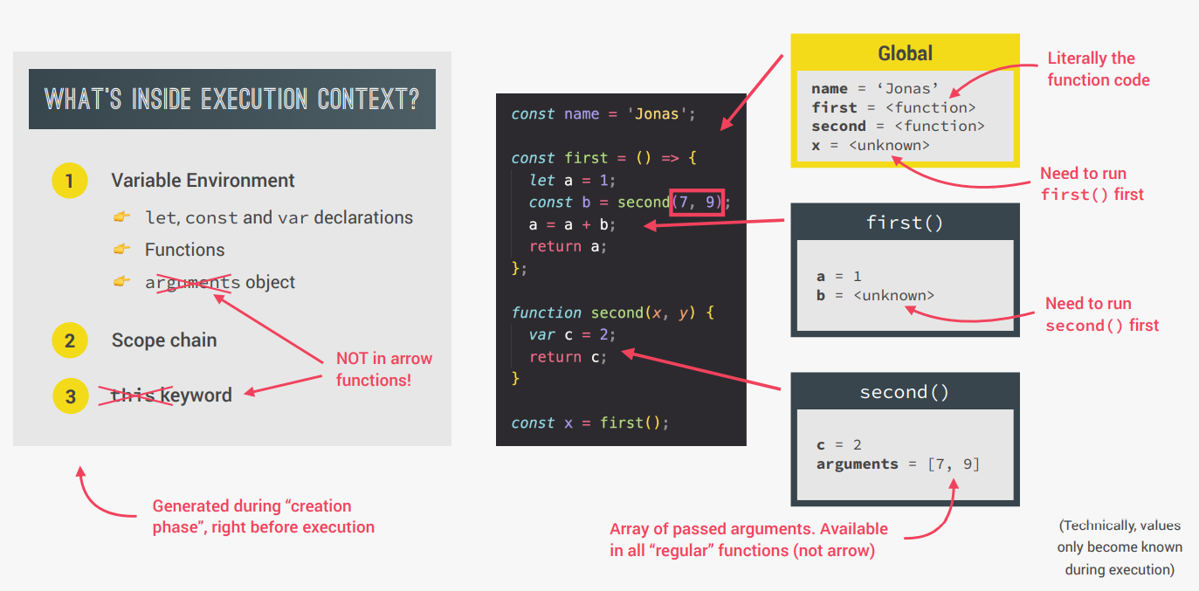
Execution context in detail

Slide 20
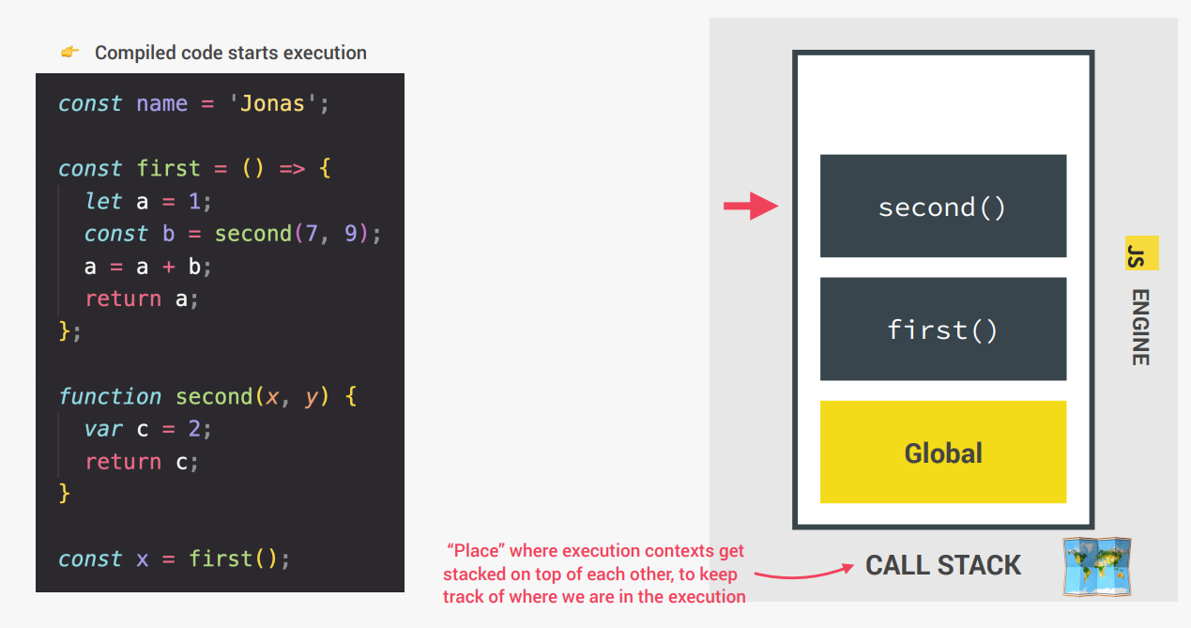
The Call Stack – (use debugger to show)

Slide 21
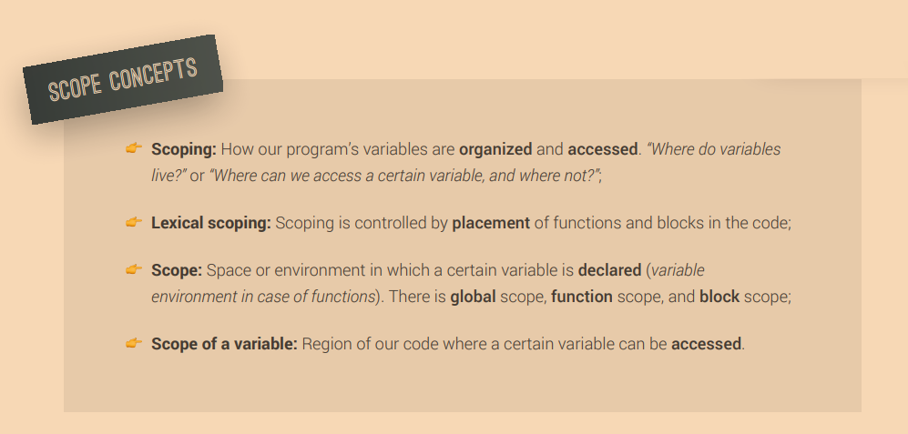
SCOPE – Scope chain

Slide 22
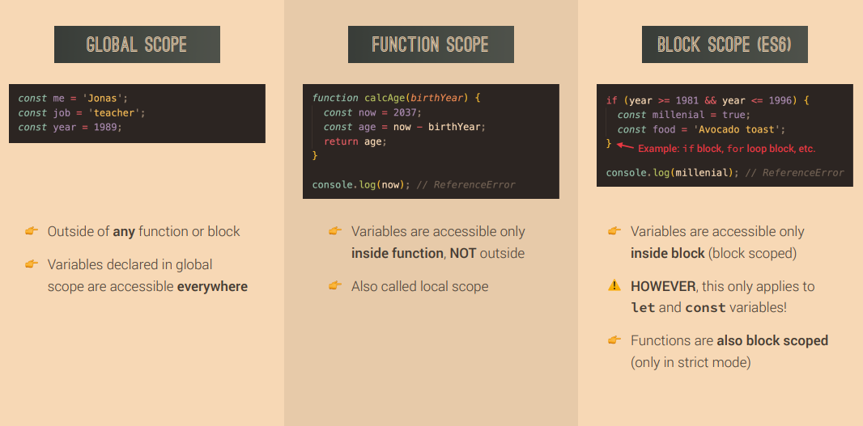
3 types of Scope

Slide 23
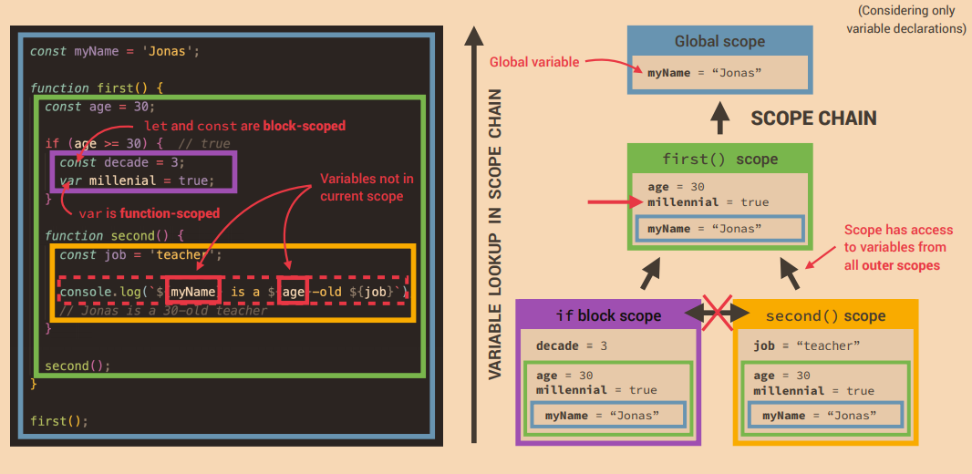
Scope chain

Slide 24
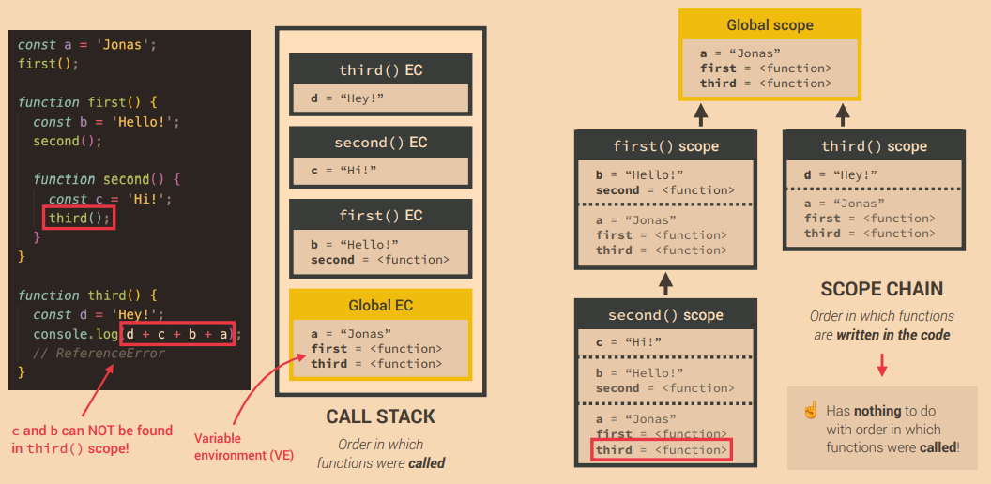
Scope chain vs Call Stack

Slide 25
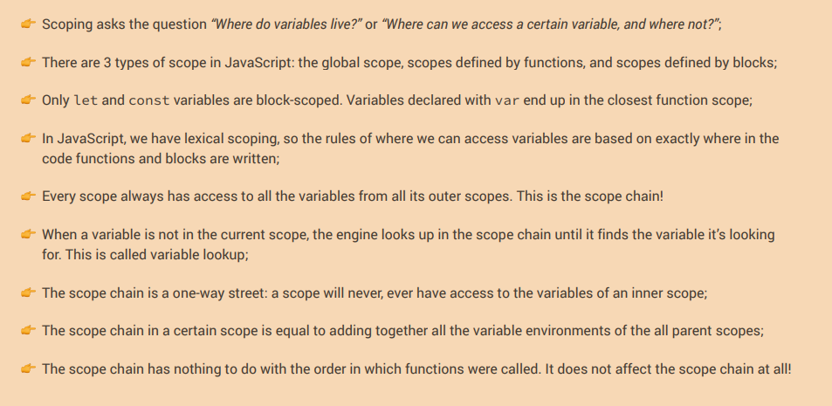
Scoping Summary

Slide 26
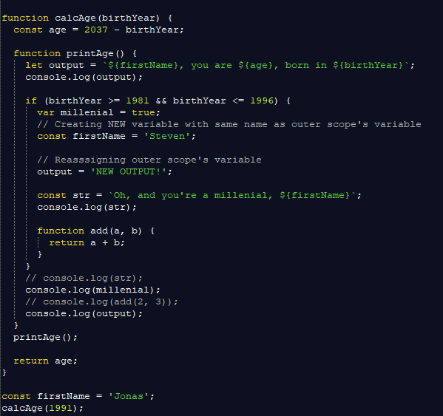
Scoping example

Slide 27
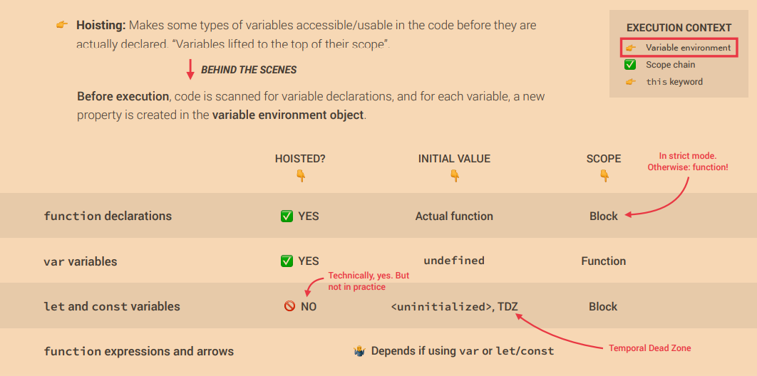
Hoisting in JS

Slide 28
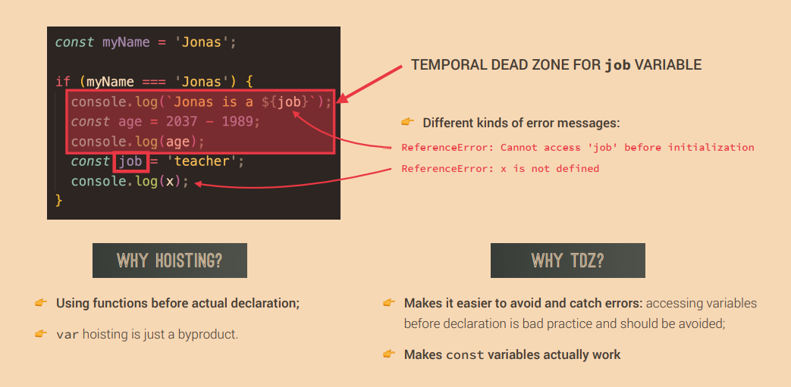
Temporal dead zone. Let and Const

Slide 29
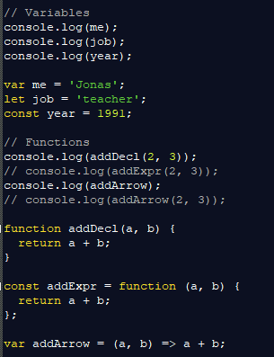
Hoisting and TDZ example

Slide 30
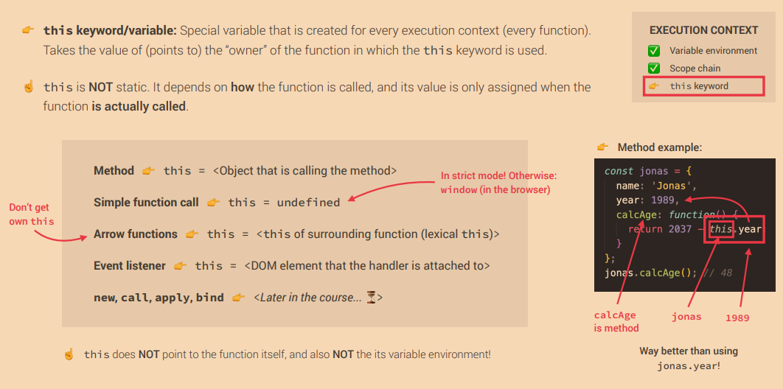
This keyword in JS

Slide 31
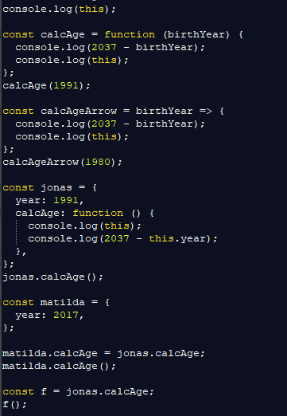
This in practice
See Matilda doesn’t have method calcAge
But we are doing the trick of borrowing the method from Jonas

Slide 32
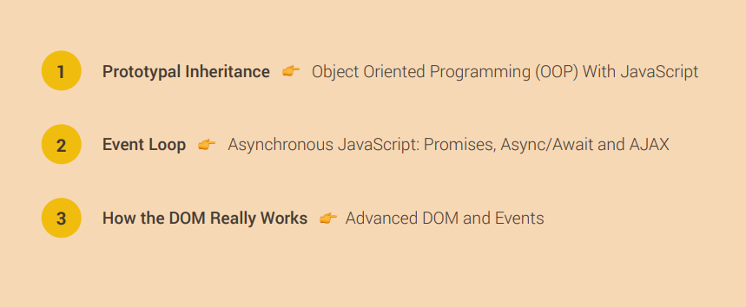
Some more advanced topics

